Slide 1
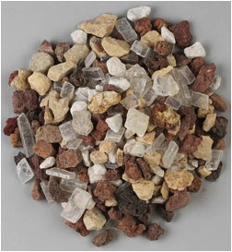
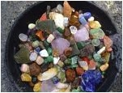
Pebbles, Sand and Silt
Earth & Space Science
Grade 2
Why do scientists study rocks?
Essential Question:

Slide 2
Earth & Space Science
Statement of enduring knowledge:
The earth and earth materials as we know them today have developed over long periods of time, through continual change and processes.

Slide 3
Earth & Space Science
Assessment Target: (K-4)
Given certain earth materials (soils, rocks or minerals) use physical properties to sort, classify, and describe them.

Slide 4
GSE’s – Earth & Space Science
ESS1 (K-2)–1
Students demonstrate an understanding of earth materials by …
1a describing, comparing, and sorting rocks and soils by similar or different physical properties (e.g., size, shape, color, texture, smell, weight).
1b recording observations/data about physical properties.
1c using attributes of properties to state why objects are grouped together (e.g., rocks that are shiny or not
shiny).

Slide 5
What is a geologist?
GEOLOGIST
A geologist is a SCIENTIST who studies the earth and earth materials such as rocks.

Slide 6
Scientists study rocks for different reasons…
Let’s see what kinds of things we can find out from taking a close look at rocks and other earth materials in this unit.

Slide 7
Exploring Three Rocks…
What do you notice?
Let’s take a look and see what we can find out…
How are rocks different?
Examine the three rocks…
Color?
Size?
Shape?
Texture?
GEOLOGIST

Slide 8
Volcanic Rocks…
Basalt
Scoria
Tuff

Slide 9
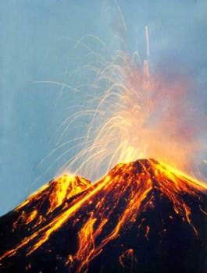
Volcanoes….

Slide 10
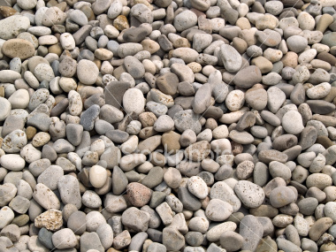
River Rocks…
Large Gravel
River
Stones

Slide 11
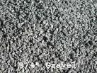
More River Rocks…
Sand
Gravel
Boulder

Slide 12
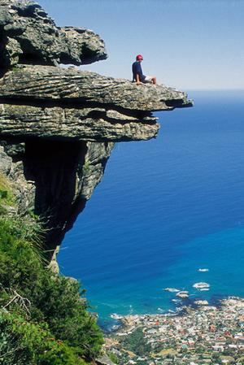
Even Bigger Rocks….
Mountains

Slide 13
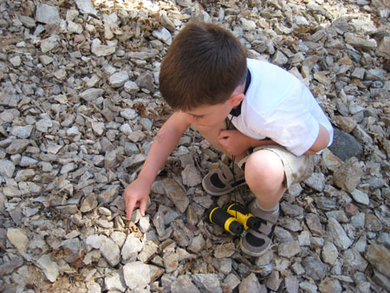
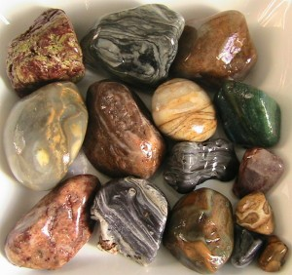
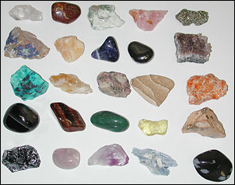
Why do people collect rocks?
Essential Question:

Slide 14
Remember doing this?

Slide 15
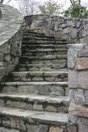
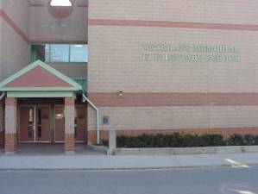
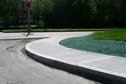
What is the importance of rocks in our everyday lives?
Essential Question:
How could we live without rocks?

Slide 16
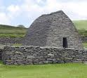
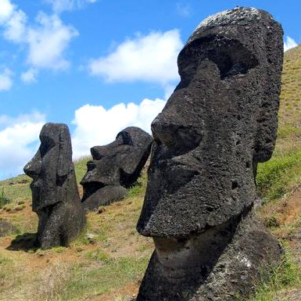
Using Rocks…
Statues
Houses
Roads
Bridges

Slide 17
Soil Explorations…
What’s in dirt?
Are all soils the same?
How do soils differ?

Slide 18
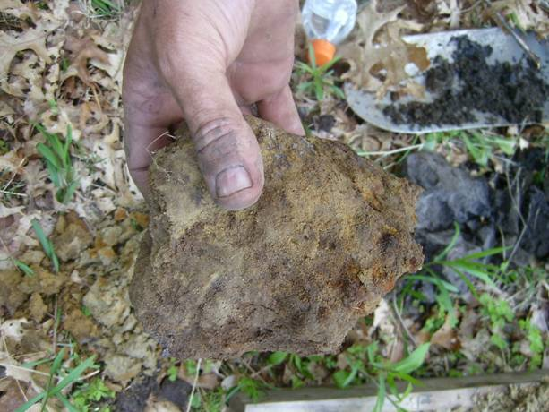
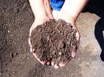
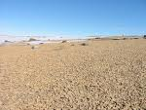
How are these soils different?

Slide 19
Do you have an answer for these questions?
Why do scientists study rocks?
Why do people collect rocks?
What is the importance of rocks in our everyday lives?
Think about it…
do you have any ideas?

Slide 20
Remember this?
Statement of enduring knowledge:
The earth and earth materials as we know them today have developed over long periods of time, through continual change and processes.

Slide 21
And this… ?
ESS1 (K-2)–1
Students demonstrate an understanding of earth materials by …
1a describing, comparing, and sorting rocks and soils by similar or different physical properties (e.g., size, shape, color, texture, smell, weight).
1b recording observations/data about physical properties.
1c using attributes of properties to state why objects are grouped together (e.g., rocks that are shiny or not
shiny).

Slide 22
And how about this one?
Assessment Target: (K-4)
Given certain earth materials (soils, rocks or minerals) use physical properties to sort, classify, and describe them.

Slide 23
Our Unit…
Students will investigate rocks and other earth materials (sand, silt, clay, soil).
Students will conduct experiments.
Students will sort and classify earth materials by looking at their physical properties and attributes.
Students will keep scientist journals to record predictions, observations, and claims and evidence.

Slide 24
PowerPoint
Students will create a PowerPoint presentation slide with a partner that demonstrates some of the new learning acquired as result of this unit.
Students will use Wordle.net to share and record (in a fun way) some words learned in rock classification and sorting.

Slide 25
www.wordle.net Sample

Slide 26
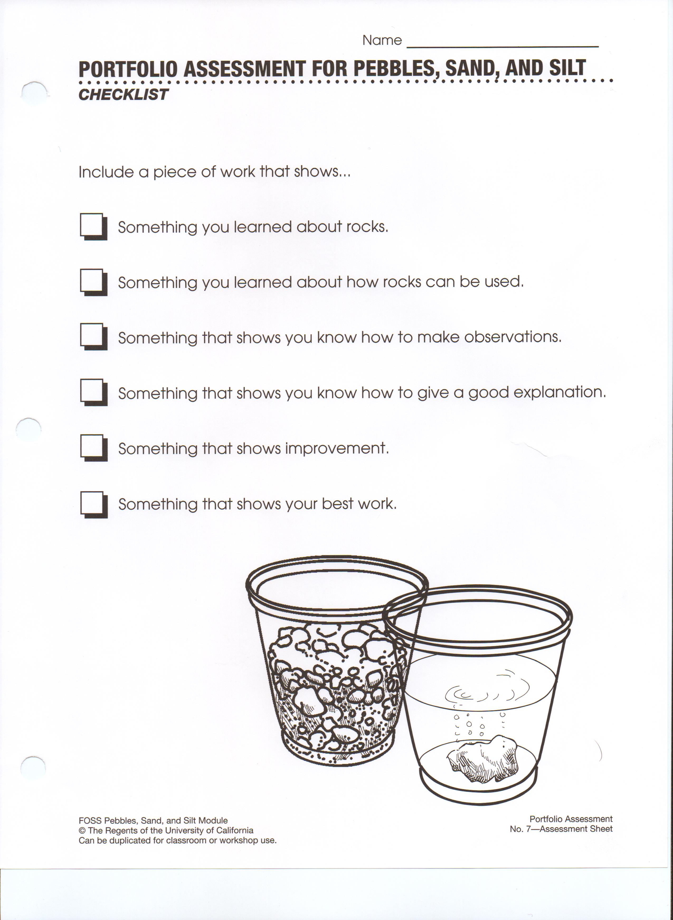
Scientist Journal Checklist & Rubric

Slide 27
Criteria Checklist for PowerPoint Project
PowerPoint Slide Must Haves…

Slide 28
NECAP
You are getting ready for the
4th grade Science NECAP…
keep up the good work!

